Slide 1

.NET MAUI on Tizen RPI
.NET MAUI Application 을 만들고
Tizen Platform RaspberryPi 에서 실행해 봅시다
김성수

Slide 2
Contents
Focus on .NET MAUI
Focus on Tizen .NET
NUI
RaspberryPi
Demo
Summary

Slide 3
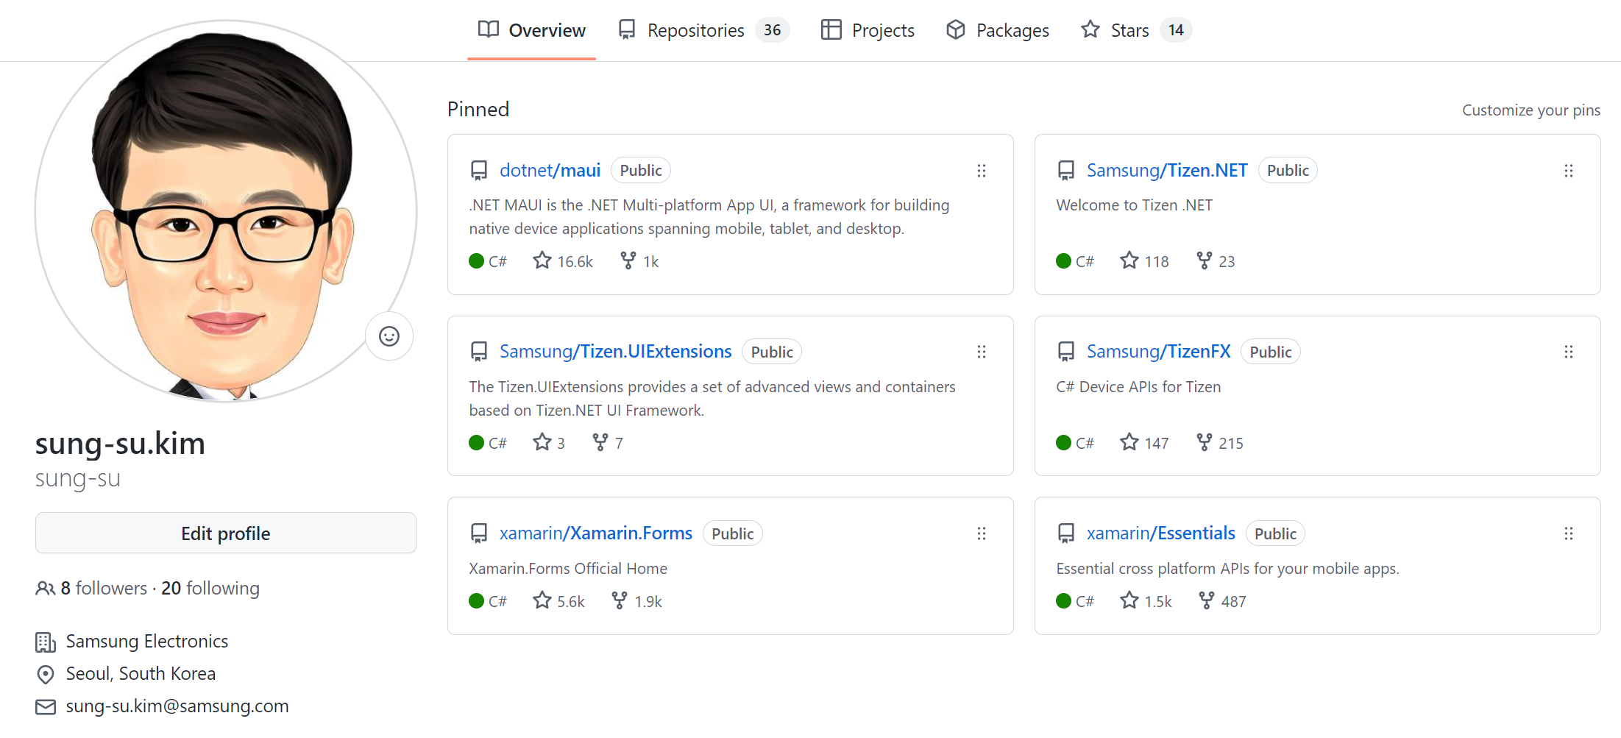

Slide 4
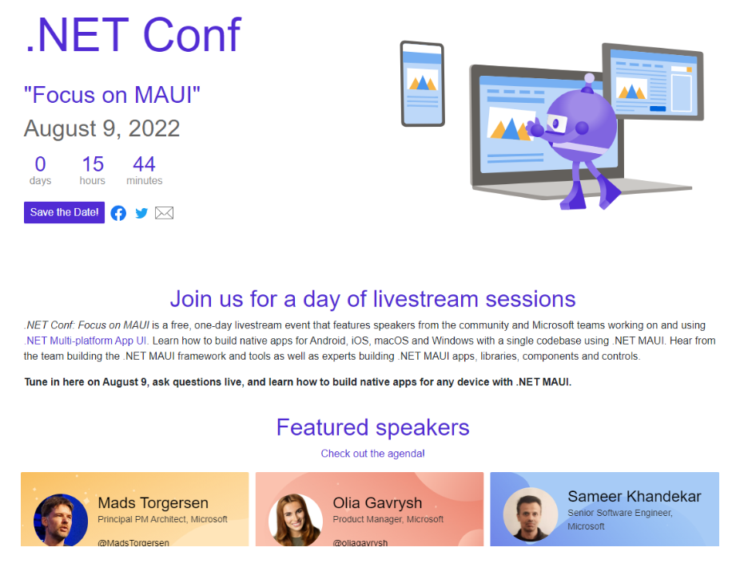

Slide 5

.NET conf focus on MAUI
Multi Platform Application UI
Cross platforms/profiles
Visual Studio 2022, v17.3 update
Single Project, Multi Targets
Performance
Productivity
Notes:
Aug, .NET conf focus on MAUI

Slide 6
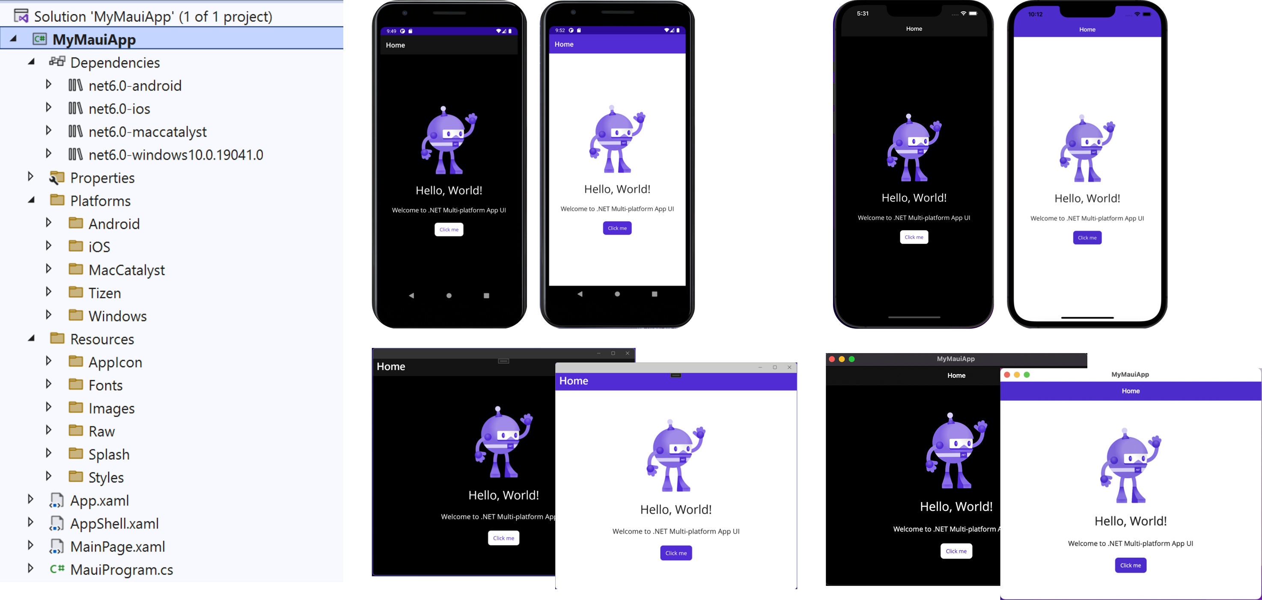
Single Project, Multi Target

Slide 7
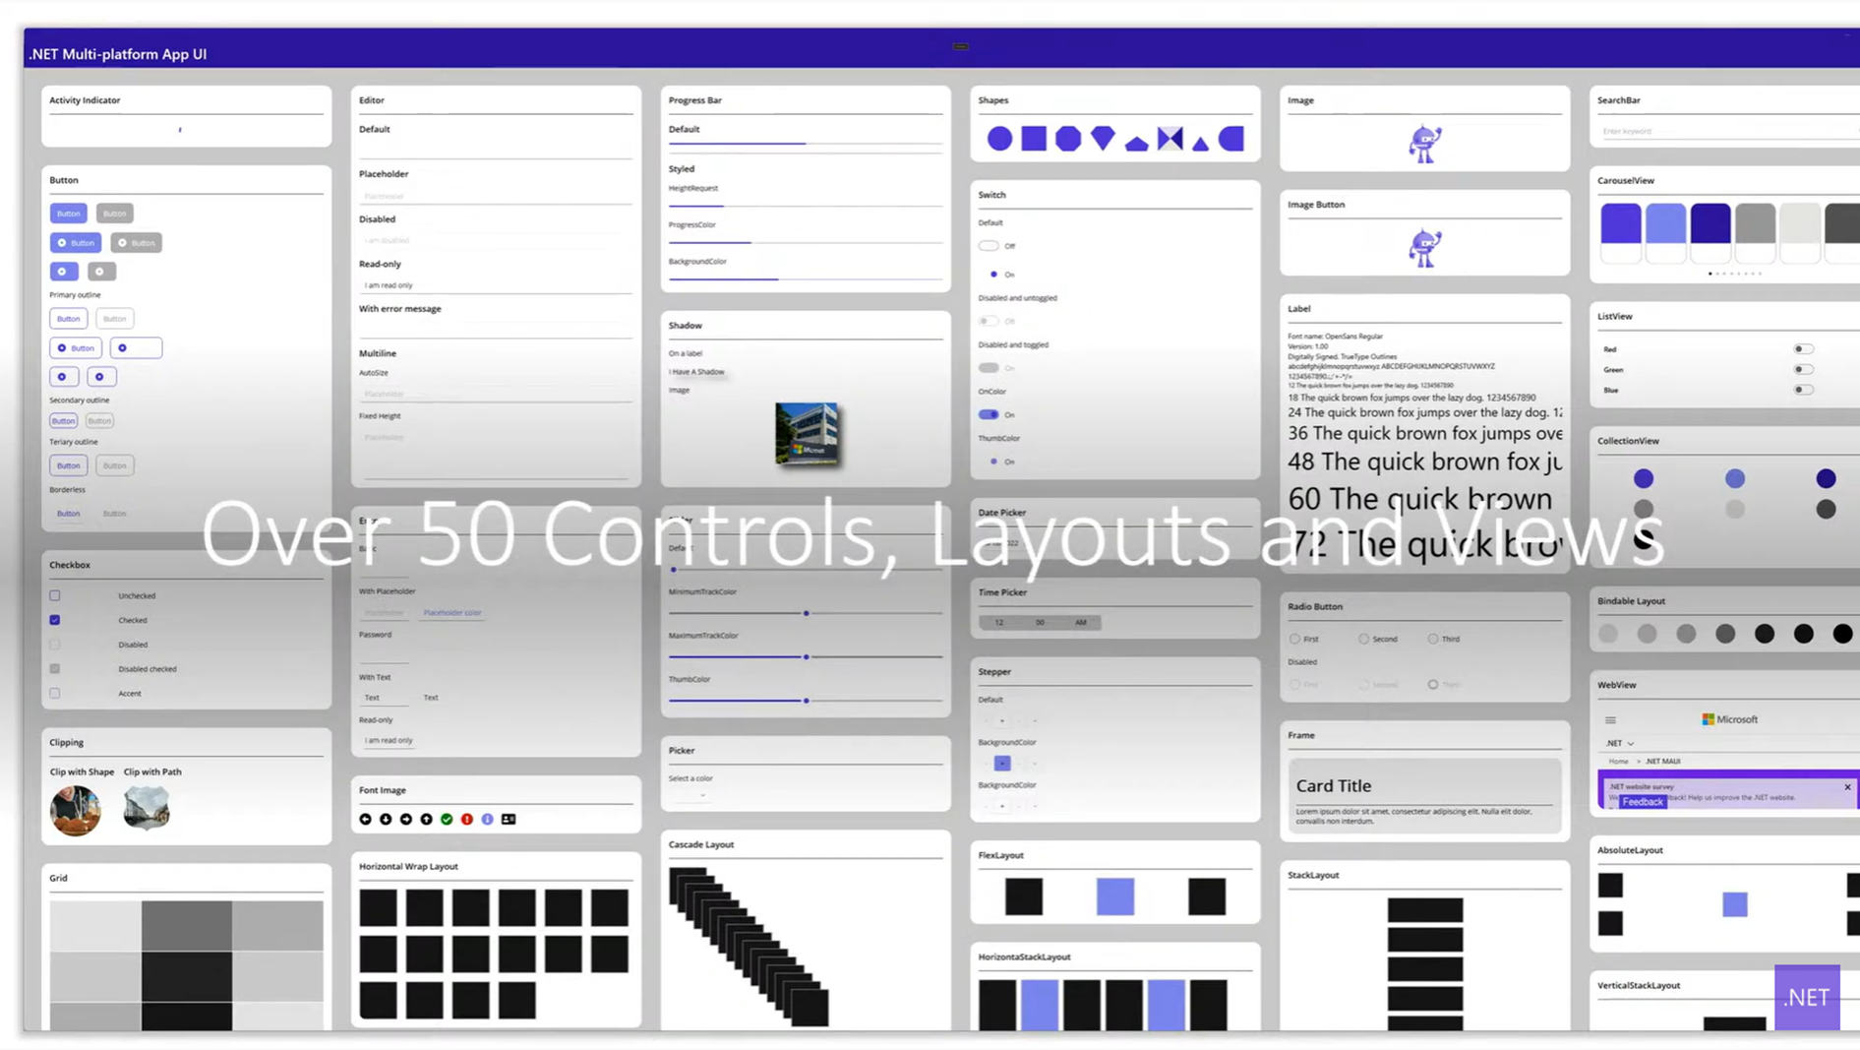
Productivity

Slide 8
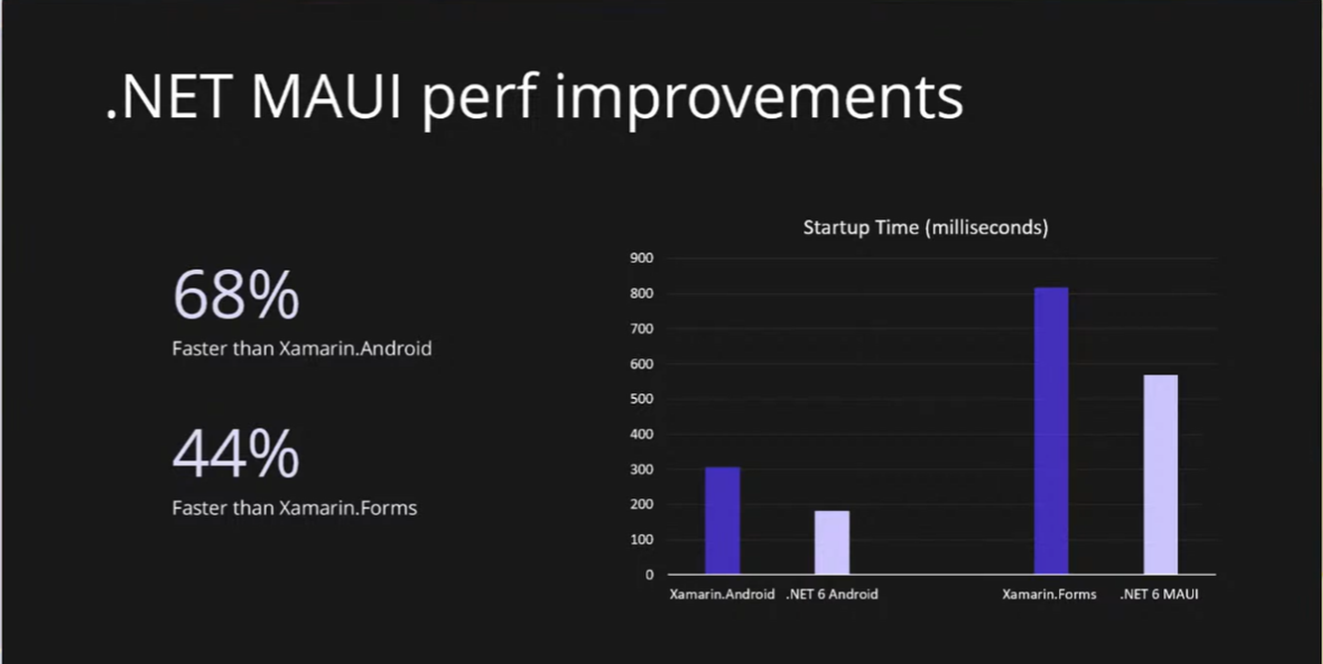
Performance

Slide 9
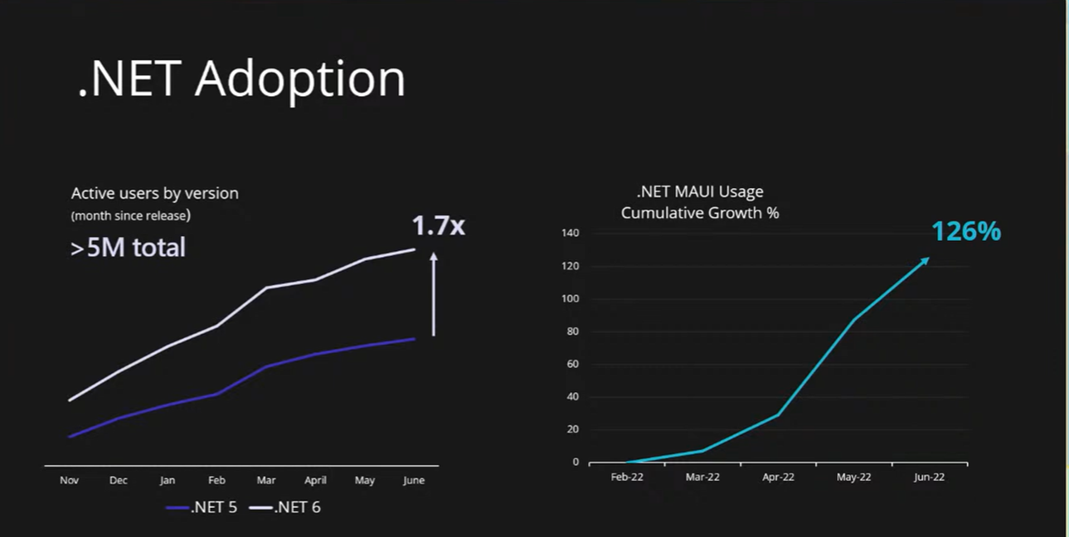
Adoption

Slide 10
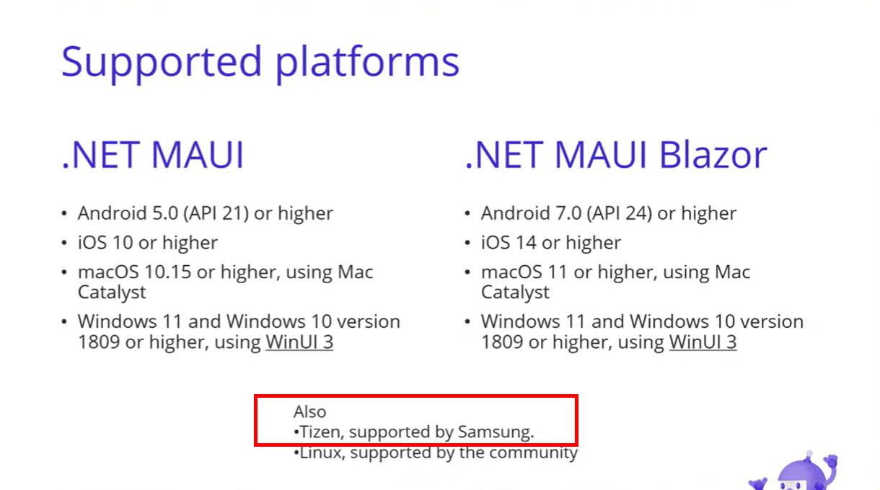
Supported Platforms

Slide 11

Tizen. NET
.NET MAUI also includes Tizen Support
From May, GA release
which is provided by Samsung Tizen.NET.
Visual Studio tools for Tizen
.NET 6 workload
Tizen SDK, Emulator etc
Notes:
Tizen 지원 상태

Slide 12


.NET MAUI focus on Tizen
Replace Backend Engine
#9619 #9620 PR
Changed Tizen Platform UI toolkit
EFL deprecated -> NUI with DALi
All handlers fixed
Profits
Notes:
after May, what happens, Replace Backend engine from EFL to NUI . Icreased Performance and Productivity.

Slide 13
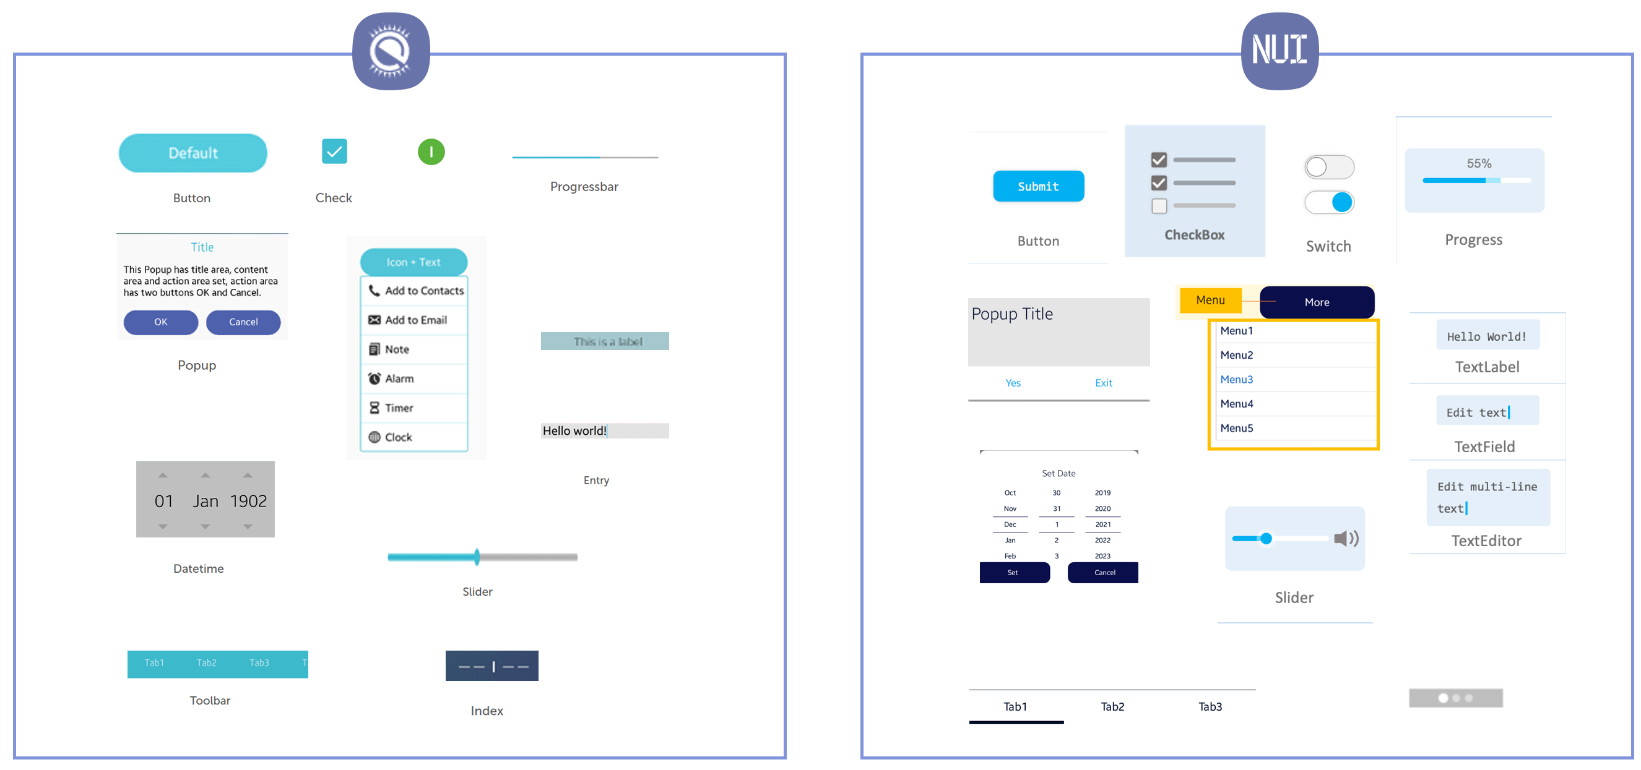
NUI Contorls

Slide 14
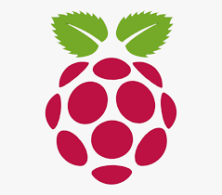
Tizen RaspberryPi
RaspberryPi 3 / 4
2017 Tizen 4.0 .NET / IoT
19, 20, 21 Seoul HW Hackathon
.NET MAUI Desktop profile
Tizen School

Slide 15
Demo
Default Template Sample
Point Of Sale
Notes:
Android, Tizen target , mobile, desktop profile

Slide 16
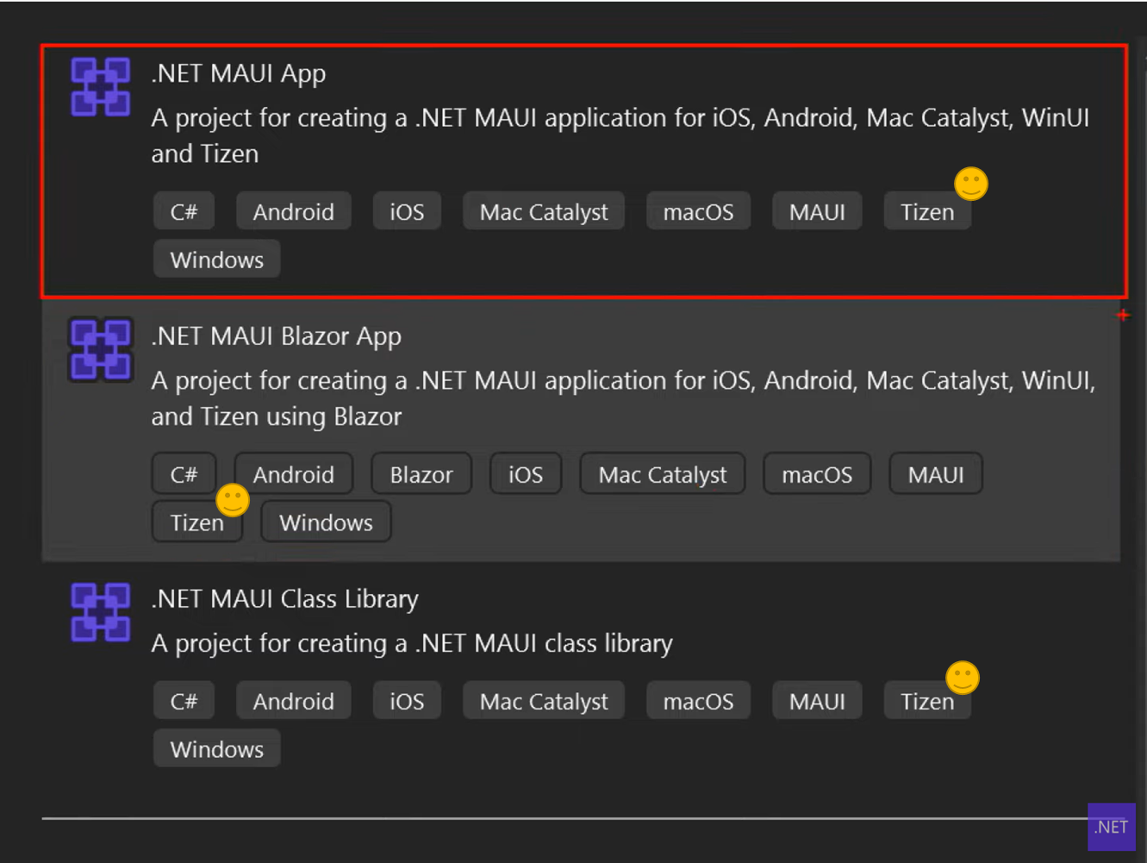
Summary

Slide 17
Summary

Slide 18
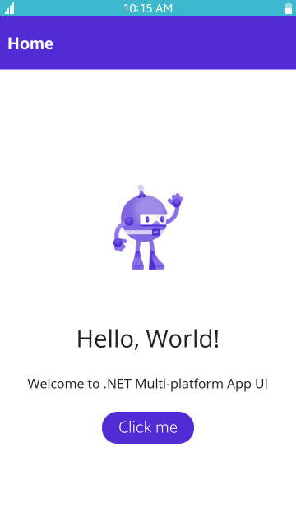
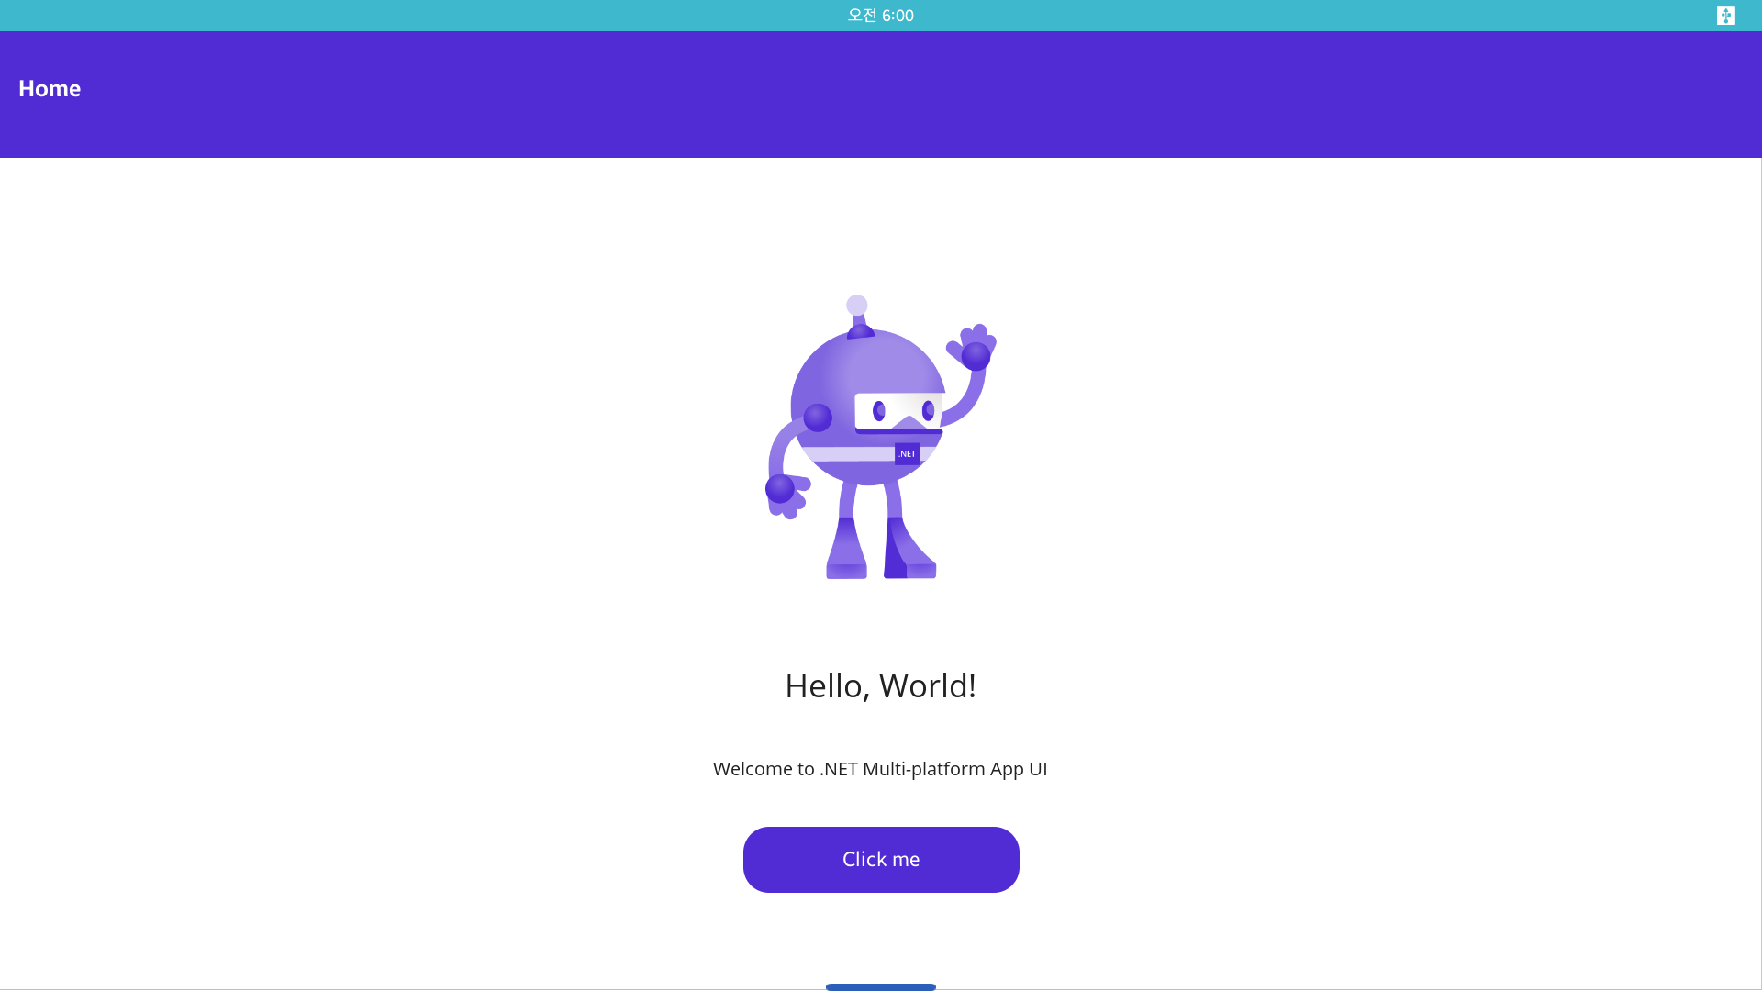
Summary

Slide 19
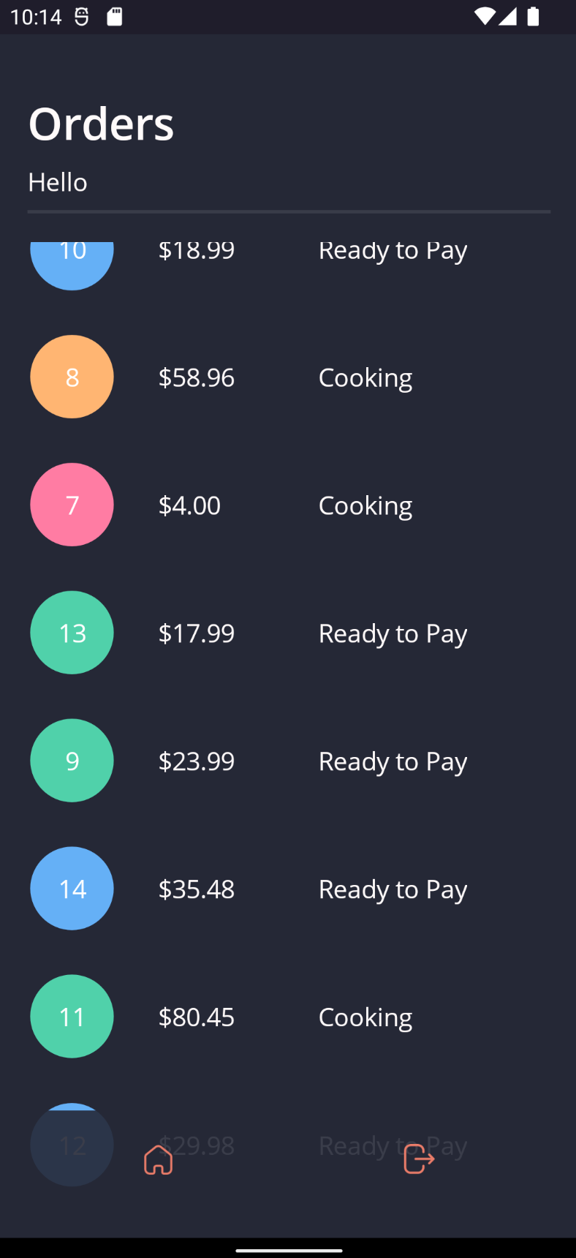
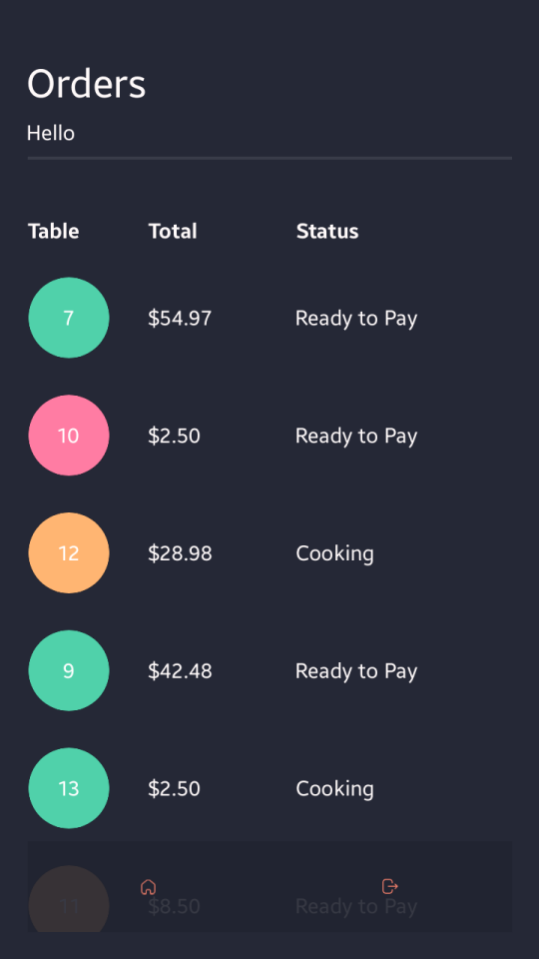
Summary

Slide 20
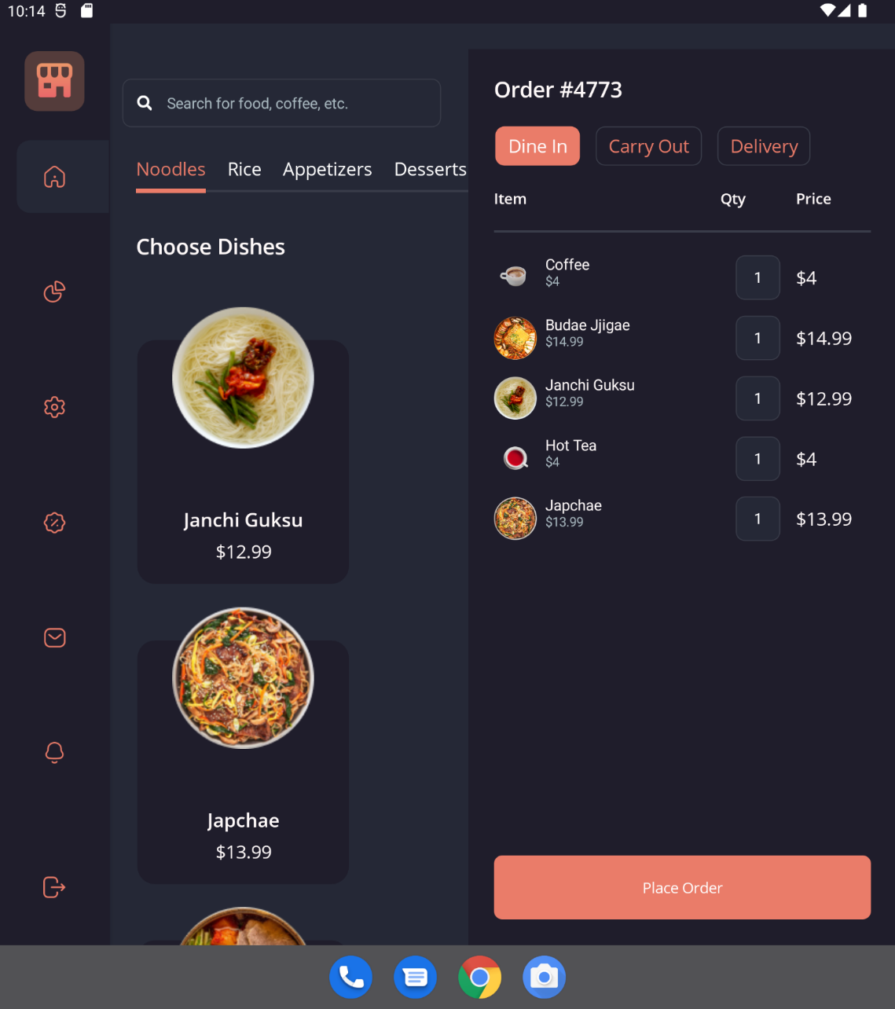
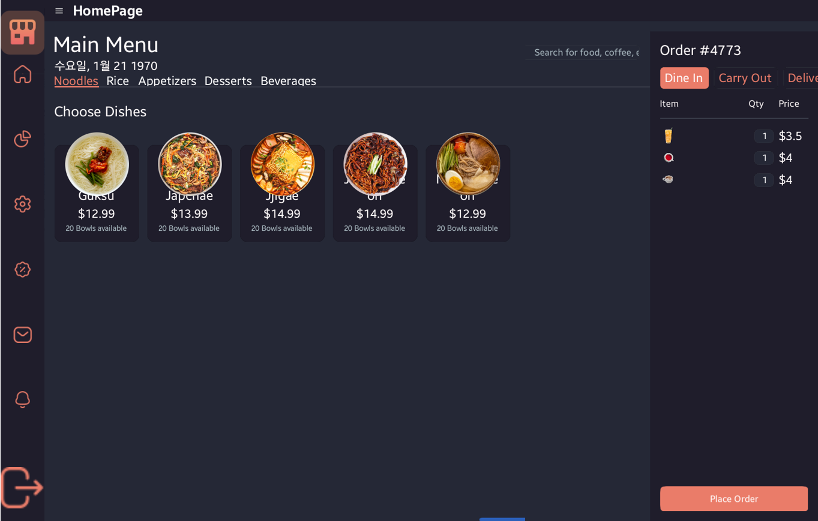
Summary

Slide 21
Summary
Issue
Not stable due to replace backend engine
Visual Studio functions testing on preview
Question & Report
https://github.com/samsung/tizen.net
tizen.net@samsung.com

Slide 22


